Slide 1
Employee Salary Predictor using AI Concepts
CAPSTONE PROJECT
Tanvi Tukaram Adivarekar
Alamuri Ratnamala Institute of Engineering and Technology (ARMIET)
AICTE Internship Student Registration ID : STU676d11fd3ff271735201277

Slide 2
Outline
Problem Statement
System Development Approach
Algorithm and Deployment
Result
Conclusion
Future Scope
References

Slide 3
Problem Statement
In today’s data-driven workforce, accurate salary prediction plays a vital role in recruitment, budget planning, and workforce management. Companies often face challenges in determining fair and competitive salaries based on various employee attributes such as education, experience, job role, and location.
This project aims to develop a machine learning model that can predict employee salaries based on relevant features, helping organizations make informed and unbiased compensation decisions

Slide 4
System Approach
Technologies Used:
Python (scikit-learn)
Google collab
Requirements:
Python 3.x
Git
VSCode

Slide 5
System Approach
Libraries Used:
Pandas – Data manipulation and analysis
NumPy – Numerical operations
matplotlib & seaborn – Data visualization
sklearn – Machine learning model building and evaluation
joblib – Model serialization
streamlit – Web app interface for model deployment

Slide 6
Algorithm & Deployment
Collected dataset
Preprocessed data using pandas (handled missing values, encoded categorical features)
Trained a regression model (e.g., Gradient Boosting Regressor)
Saved the trained model using joblib
Created a Streamlit web app to take user input and display predictions
Integrated the trained model into the Streamlit app for real-time inference
Deployed the app using Streamlit Cloud for public access

Slide 7
Result
Github Link:
https://github.com/Tanvi-Adivarerkar/AI_Edunet_Project.git

Slide 8
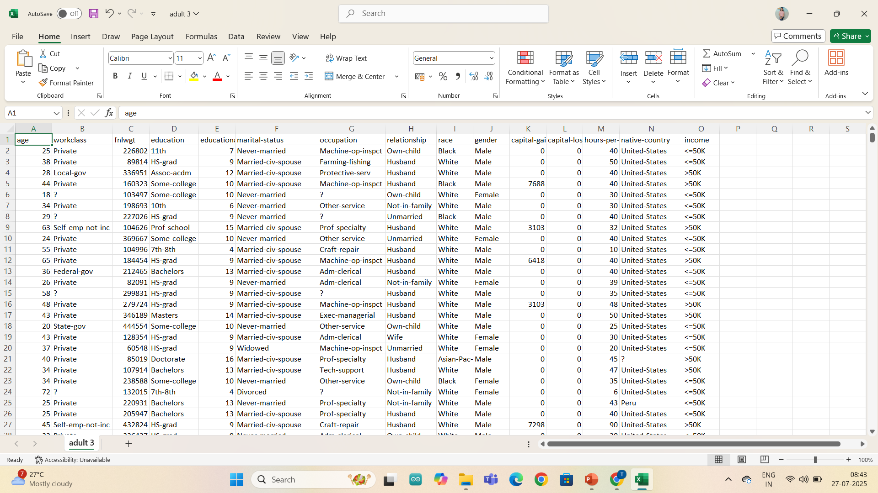
Data set

Slide 9
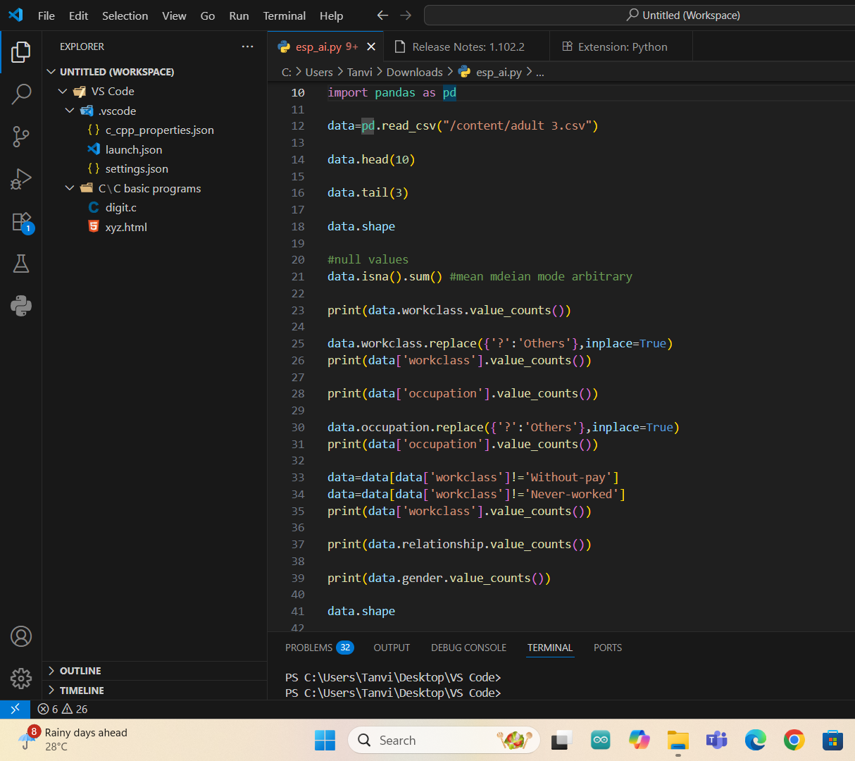
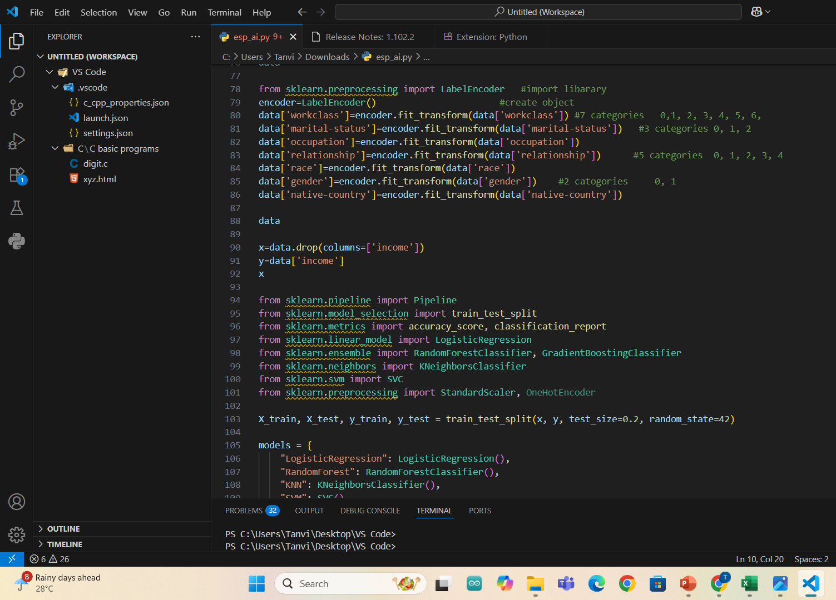
Code Preview

Slide 10
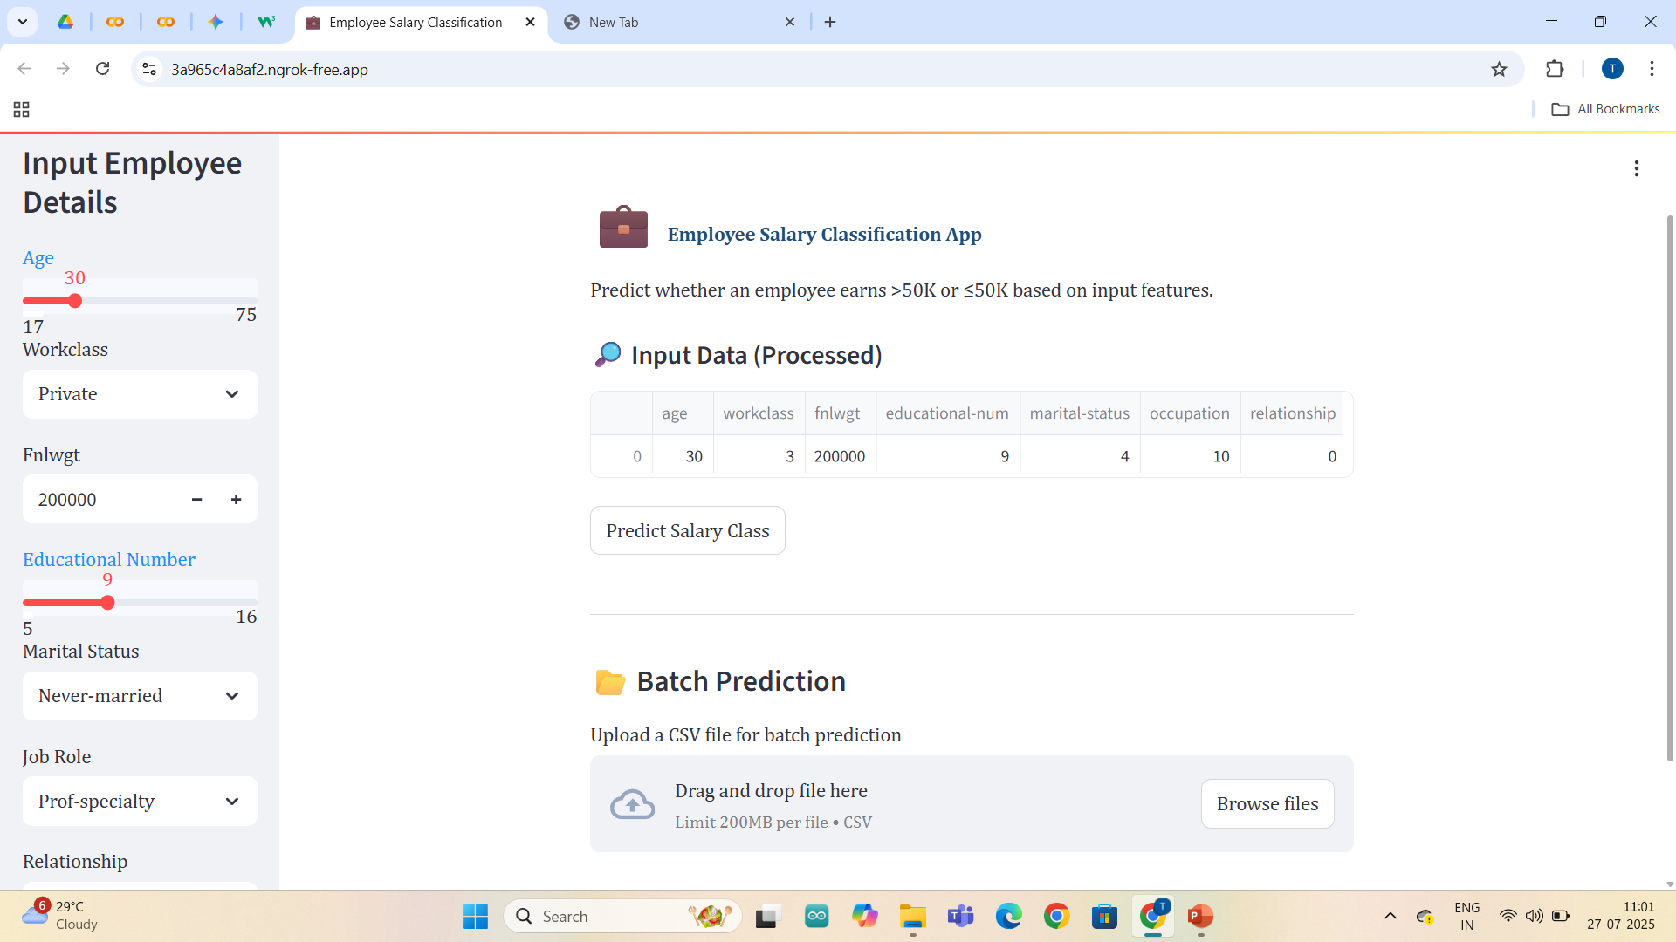
Project Preview & Output

Slide 11
Conclusion
Successfully developed a regression model to predict employee salaries using key features like education, experience, and job role.
Gradient Boosting Regressor provided reliable predictions with good accuracy metrics.
A user-friendly Streamlit web app was built to allow real-time salary prediction based on user input.
The project demonstrates how machine learning can support HR and finance departments in making data-driven compensation decisions.
Future improvements can include using larger and more diverse datasets, adding location-based features, and integrating with real-world HR systems.

Slide 12
Future Scope
Advanced Algorithms Explore deep learning models or ensemble techniques like XGBoost, CatBoost for enhanced accuracy.
Feature Enhancement Incorporate additional features such as job location, company size, industry type, and performance ratings.
Real-time Data Integration Integrate APIs to fetch live employee data from HR systems for automated predictions.
Role-based Recommendation System Suggest suitable salary ranges for specific roles based on current market trends.

Slide 13
References
Scikit-learn Documentation – https://scikit-learn.org/
Streamlit Documentation – https://docs.streamlit.io/
Pandas Documentation – https://pandas.pydata.org/docs/
Joblib – https://joblib.readthedocs.io/
Seaborn Documentation – https://seaborn.pydata.org/
Matplotlib – https://matplotlib.org/stable

Slide 14
THANK YOU !!!

